Slide 1
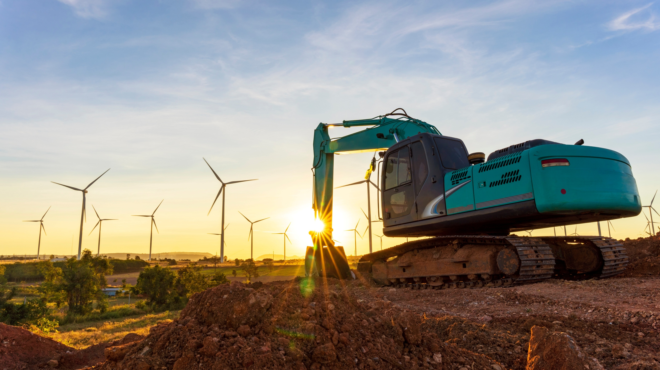
ERA KPI Framework Version 3.0
User Guidance
April 2025
Document status: Confidential – Final Draft
© Copyright EPINDEX Ltd (epi) 2025. All rights reserved. May not be reproduced or shared without written permission
Notes:
Backhoe front loader excavator and wind turbines that are generating electricity in the background, the concept of sustainable resources, Beautiful sky with wind generators turbines, Renewable energy.

Slide 2
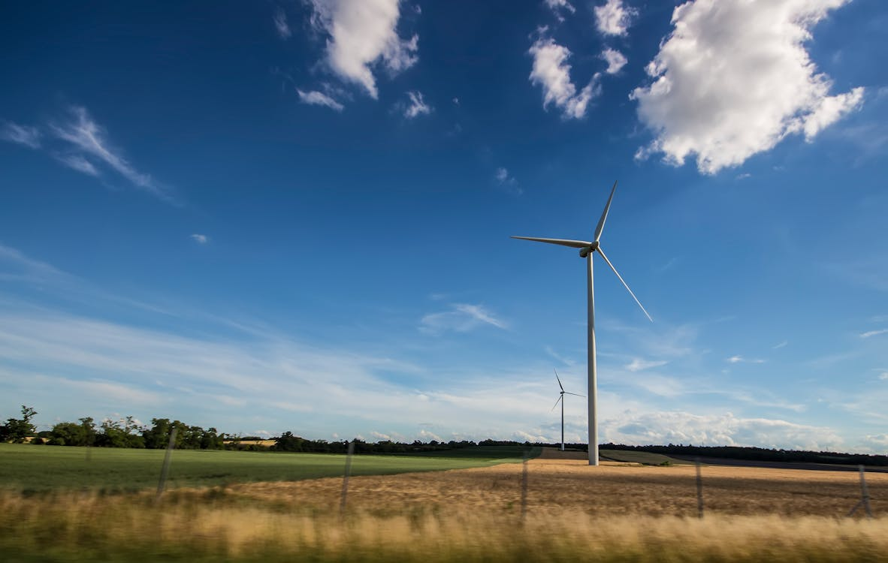
1
Introduction to Sustainability KPI Framework Version 3.0
2
SME KPIs
3
Large Undertaking KPIs
4
KPI Framework Development Process

Slide 3
Introduction to Sustainability KPI Framework Version 3.0
SMEs
Large Undertakings
(a) Basic
(b) Comprehensive
(a) Basic
(b) Comprehensive
Purpose of the ERA KPI Framework in the rental sector
The ERA Sustainability KPI framework provides a practical approach for rental companies implementing a sustainability measurement and reporting framework. Using this objective industry framework, rental companies can adopt or improve Sustainability KPIs, using either a Basic or Comprehensive framework depending on their current size, level of maturity and goals.
Background
Application
Structure
Comprehensive KPIs
Framework Development
The Sustainability KPI Framework was first created in 2021 through a review of over 17 rental companies operating in Europe and the US (Version 1.0). It was then updated in 2023 (Version 2.0) and now again in 2025 (Version 3.0) to account for changes in sustainability reporting requirements in the EU, such as the Corporate Sustainability Reporting Directive (CSRD).
Version 3.0
The newest version of the Framework was created by reviewing relevant topical areas with leading European-based rental organisations. The KPI selection was based on alignment of these topical areas with CSRD reporting standards (ESRS and VSME), plus a selection of supplementary KPIs from the 2.0 ERA framework that are rental sector specific and not covered by CSRD standards.
Stakeholders
Stakeholders (customers, investors, staff, suppliers, regulators, government agencies, NGOs, to name some critical stakeholders) expect, and in some cases increasingly require, rental companies to put in place Key Performance Indicators (KPIs) to measure sustainability performance levels, set targets and report progress against these targets.
EU Sustainability Reporting Objectives
This Version 3.0, prepared for ERA by epi Consulting, provides a sustainability KPI framework that will enable rental companies to implement a flexible solution that considers the size and level of maturity of an organisation, and meet current EU Corporate Sustainability Reporting Directive (CSRD) objectives.
The ERA Sustainability KPI Framework 3.0 is split into 4 lists of recommended KPIs – 2 lists for SMEs and 2 lists for Large Undertakings
For each organisation size, KPIs have been grouped into two categories:
Basic KPIs – KPIs that are most frequently looked at by stakeholders, are most closely aligned with current and future minimum standards for regulatory reporting and are in most common usage.
Comprehensive KPIs – KPIs that can be regarded as good/best practice in sustainability measurement and reporting and would be considered leading practice by stakeholders.

Slide 4
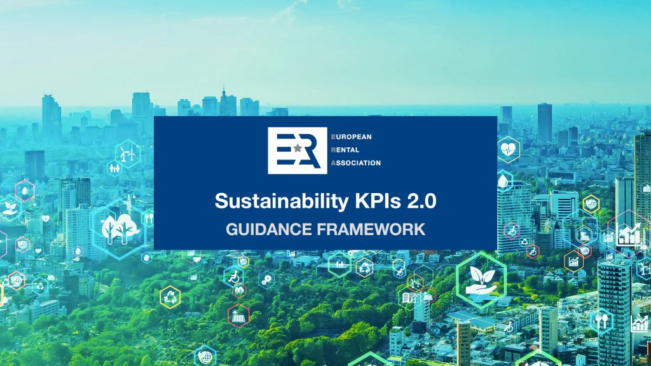
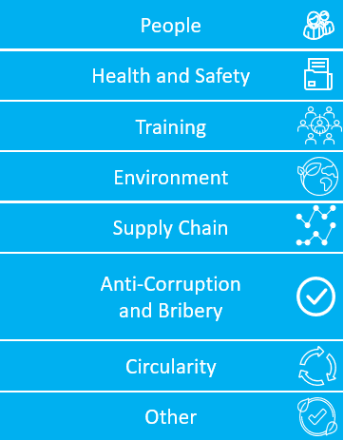
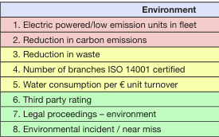
Introduction to Sustainability KPI Framework Version 3.0
SMEs
Large Undertakings
(a) Basic
(b) Comprehensive
(a) Basic
(b) Comprehensive
Development of Sustainability KPI Framework from 2.0 to 3.0
Presented below is the KPI framework 2.0 areas and a summary of updates made to version 3.0:
Framework 2.0
Framework 3.0
epi Consulting were commissioned by the European Rental Association (ERA) to re-develop the KPI framework 2.0 to align it with the requirements and topical areas under the Corporate Sustainability Reporting Requirements (CSRD).
The new Framework 3.0 considers organization size, material sustainability areas in the rental sector and different levels of reporting maturity and ambition. The four disclosure lists are summarized below and explained in more detail later in this report.
Rental companies are recommended to report under one of the four KPI lists only:
Three KPI sets:
KPI category areas:
ESRS KPI category areas:
Four KPI lists:
E1 – Climate Change
SME Rental Companies
(a) Basic KPIs – minimum disclosures (for example, Scope 1 and 2 emissions)
E2 – Pollution
Example:
E3 - Water
(b) Comprehensive KPIs – Basic KPIs above + additional (eg. Scope 3)
E5 - Circularity
S1 – Own Workforce
Large Rental Companies
(a) Basic KPIs – CSRD reporting “getting started”
S2 – Workers in the Value Chain
S4 – Consumers and End Users
(b) Comprehensive KPIs – Aligning with CSRD good and best practice
G1 - Governance

Slide 5
Introduction to Sustainability KPI Framework Version 3.0
SMEs
Large Undertakings
(a) Basic
(b) Comprehensive
(a) Basic
(b) Comprehensive
How to Apply the Framework: Selecting a KPI List
ERA members can use the following decision tree to determine which KPI list would be most appropriate for them to use, with detailed guidance set out in the following sections. ERA members only need to consider one KPI list.
Minimum
The minimum “getting started” KPIs that SME rental companies should consider measuring, tracking and disclosing.
(a) SME: Basic KPIs
SME
SME Rental Companies
Is your organisation aiming for a minimum “getting started” sustainability reporting compliance or interested in a good/best practice, more in-depth disclosure?
Is your organisation classified as a small or medium sized enterprise (SME) or a large undertaking?
2 of 3 criteria to be met: <250 employees; <EUR50m revenue; <25m assets)
See Section 2
SME members wishing to enhance their sustainability indicators or cover all those potentially required by stakeholders may also wish to add Comprehensive KPIs.
(b) SME: Comprehensive KPIs
Good/best practice
Minimum
A minimum list of KPIs for Large Rental Companies, providing the most meaningful sustainability performance indicators.
(a) Large Undertaking: Basic KPIs
Large undertaking
Large Rental Companies
Is your organisation aiming to comply with EU sustainability regulation or interested in making a good/best practice CSRD disclosure?
2 of 3 criteria: >250 employees; >EUR50m revenue; >25m assets
See Section 3
A full list of typically material measures for large rental organisations aiming for a complete, leading practice set of performance indicators.
(b) Large Undertaking: Comprehensive KPIs
Good/best practice

Slide 6
1
Introduction to Sustainability KPI Framework Version 3.0
2
SME KPIs
3
Large Undertaking KPIs
4
KPI Framework Development Process

Slide 7
SME KPIs
SMEs
Large Undertakings
(a) Basic
(b) Comprehensive
(a) Basic
(b) Comprehensive
Overview of SME KPI Lists
The below table summarises the KPIs included in the SME section of the KPI Framework
 | Summary of KPI topic areas | Number of metrics in Basic Framework | Numbers of metrics in Comprehensive Framework
Environment | B3 – Energy and Greenhouse Gas Emissions – covers organisation’s impact on climate through its energy usage and greenhouse gas emissions including energy consumption, scope 1 GHG emissions, Scope 2 Location-based GHG Emissions and GHG intensity B7 - Resource use, Circular Economy and Waste Management – covers the application of circular economy principles; annual waste (non-hazardous and hazardous); annual waste recycled or reused, annual mass flow of relevant materials Comprehensive only – scope 3 GHG emissions by category, scope 1,2,3 reduction targets and key carbon reduction actions | 8 | 12
Social | B8 - Workforce, General Characteristics – covers the organisation’s workforce through disclosures of employment contracts; employees by gender; country of employment contract; employee turnover rate B9 - Workforce, Health and Safety – covers recordable work-related accidents and fatalities B10 - Workforce, Remuneration, Collective Bargaining and Training – covers employees receiving pay equal to or above minimum wage; gender pay gap; collective bargaining; training hours, by gender Comprehensive only – male-female gender ratio, number of contractor and agency staff | 10 | 13
Governance | B11 - Business Conduct – covers the disclosure of convictions and fines for corruption and bribery - number of convictions and the total amount of fines Comprehensive only – board gender diversity | 2 | 3
Supplementary | Comprehensive only – additional rental-specific KPIs in the areas of People, Training, Environment and Supply Chain | N/A | 6
 |  | 20 | 34
Total:

Slide 8
SME KPIs
SMEs
Large Undertakings
(a) Basic
(b) Comprehensive
(a) Basic
(b) Comprehensive
How to apply the SME KPI Lists
If your organisation is a Small or Medium Enterprise (SME), please refer to the tab ‘SME’ tab in the Excel file ERA Sustainability KPI Framework 3.0 Detailed KPI List.
How to use the SME tab
Guidance on specific topics/IRO exposure
Step 1. Use the decision tree on p5 to determine if your organisation uses the basic or comprehensive KPI list.
Step 2. On the SME tab, filter in columns I and J to “Yes” to see all relevant KPIs (see screenshot below). Assess if any of these KPIs are not relevant for your organisation i.e. considering geographic location, service lines and any other factors that vary by company.
Step 3. Assess greyed out entries that have not been included but could be relevant. For example, B5 – Biodiversity is not included in either the basic and comprehensive list. However, if biodiversity loss or disruption to ecosystems for rental equipment is an area of risk at your organisation specifically, you may wish to consider making relevant disclosures.
Step 4. Form your final KPI list and prepare a disclosure using that list.
Companies wishing to report transparently should consider making organisation-specific disclosures if indicated by their CSR risk assessment. For example:
Companies operating or procuring from outside Europe, especially where low labour standards or corruption may exist, may consider additional disclosures relating to human rights or Anti-Bribery & Corruption (ABC).
Companies offering equipment which uses large amounts of water may wish to consider reporting on water-related metrics.
Companies may wish to consider the wider downstream impact of the industries in which they offer their services e.g. Oil & Gas
Snapshot from SME tab:
Columns I and J set out different requirements under SME basic v comprehensive:
Additional guidance
The SME KPI list is based on the Voluntary reporting standard for SMEs (VSME) Standard.
Existing ERA KPI Framework

Slide 9
1
Introduction to Sustainability KPI Framework Version 3.0
2
SME KPIs
3
Large Undertaking KPIs
4
KPI Framework Development Process

Slide 10
Large Undertaking KPIs
SMEs
Large Undertakings
(a) Basic
(b) Comprehensive
(a) Basic
(b) Comprehensive
Overview of Large Undertaking KPI Lists
ESRS Topics | Typical materiality* | ESRS – sub-topic areas | Large Undertaking: Basic* |  | Large Undertaking: Comprehensive*
 | Metrics and Targets used - quantitative and easily comparable | Metrics | Targets | Metrics | Targets
ESRS | n/a |  | 4 | 0 | 4 | 0
E1 – Climate Change | all sub-topics material | Climate change adaption, climate change mitigation and energy | 90 | 21 | 99 | 21
E2 – Pollution | air and water only material | Pollution of air and soil | 0 | 0 | 10 | 0
E3 – Water | water only material | Water consumption, water withdrawal, water discharge | 0 | 0 | 12 | 0
E4 – Biodiversity | not material | Not typically assessed as material | 0 | 0 | 0 | 0
E5 – Circularity | all sub-topics material | Resource inflows, resource outflows (related to products and services) and waste | 11 | 0 | 11 | 0
S1 – Own Workforce | all sub-topics material | Employment and conditions, health and safety, equality and fairness, worker rights | 69 | 0 | 69 | 0
S2 – Workers in the Value Chain | material but no suitable metrics/targets | Employment and conditions, health and safety, equality and fairness, worker rights including child labour/forced labour | 0 | 0 | 0 | 0
S3 – Affected Communities | not material | Not typically assessed as material | 0 | 0 | 0 | 0
S4 – Consumers and End-Users | only consumer safety material | Personal safety of consumers and/or end-users | 0 | 0 | 1 | 0
G1 – Governance | material apart from animal welfare | Corporate culture, protection of whistle-blowers, political engagement and lobbying, corruption and bribery, relationship with suppliers | 10 | 0 | 15 | 0
Sub-total |  | 184 | 21 | 221 | 21
Entity Specific KPIs |  | + Minimum ERA KPIs |  | + Minimum + Good + Best ERA KPIs
Supplementary Rental Specific KPIs | Additional rental specific KPIs that were not covered in ESRS | 4 | 0 | 12 | 0
TOTAL (by data point type) |  | 188 | 21 | 233 | 21
TOTAL |  | 209 |  | 254
*Note: To comply with CSRD, large undertakings and listed SMEs should still complete a Double Materiality Assessment to determine individual reporting requirements. This framework simply provides guidance on commonly material metrics.

Slide 11
Large Undertaking KPIs
SMEs
Large Undertakings
(a) Basic
(b) Comprehensive
(a) Basic
(b) Comprehensive
How to apply the Large Undertaking KPI Lists
If your organisation is a Large Undertaking, please refer to the tabs ‘Large Undertaking’ in the Excel file ERA Sustainability KPI Framework 3.0 Detailed KPI List. The KPIs are listed over several tabs, under each of the topic ESRS areas, plus one tab with supplementary rental specific KPIs.
How to use the Large Undertaking tabs
Guidance on specific topics/IRO exposure
Step 1. Use the decision tree to determine if your organisation is using the basic or comprehensive KPI list.
Step 2. Review all Large undertaking tabs in the spreadsheet (tabs are highlighted in orange). Filter “Y” in all the tabs to determine the relevant KPIs (see screenshot below). Assess if any of theses KPIs are not relevant for your organisation i.e. considering geographic location, service lines and any other factors that vary by company.
Step 3. Assess if any of the blank entries could be relevant to your organisation. This could be done as part of completing a full Double Materiality Assessment. For example, B5 – Biodiversity is not included in either the basic and comprehensive list. However, if biodiversity loss or disruption to ecosystems for rental equipment is an area of risk at your organisation specifically, you may wish to consider making relevant disclosures.
Step 4. Form your KPI list and prepare a disclosure using that list. This may inform part your CSRD disclosure*
Companies reporting under CSRD should consider making additional organisation-specific disclosures if indicated by their Double Materiality Assessment. For example:
Companies operating or procuring from outside Europe, especially where low labour standards or corruption may exist, may consider additional disclosures relating to human rights or ACB.
Companies offering equipment which uses large amounts of water may wish to consider reporting on water-related metrics.
Companies may wish to consider the wider downstream impact of the industries in which they offer their services eg. Oil & Gas
Example tab:
Filter on different requirements under basic v comprehensive:
Additional guidance
On every tab, use the column with title ‘Name’ to find detailed guidance on each KPI (by opening the links in blue)
*Note: To comply with CSRD, large undertakings and listed SMEs should still complete a Double Materiality Assessment to determine individual reporting requirements. The framework simply provides guidance on commonly material metrics.
11

Slide 12
1
Introduction to Sustainability KPI Framework Version 3.0
2
SME KPIs
3
Large Undertaking KPIs
4
KPI Framework Development Process

Slide 13
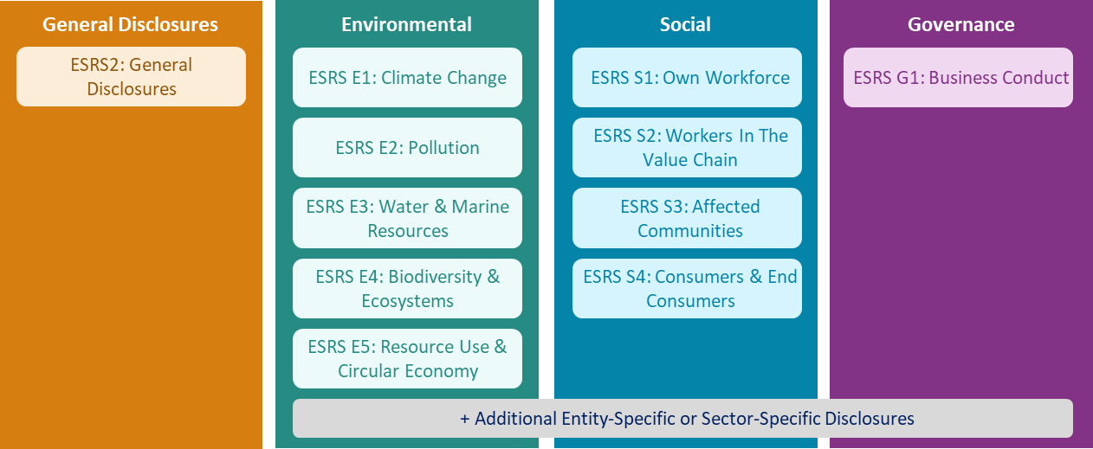
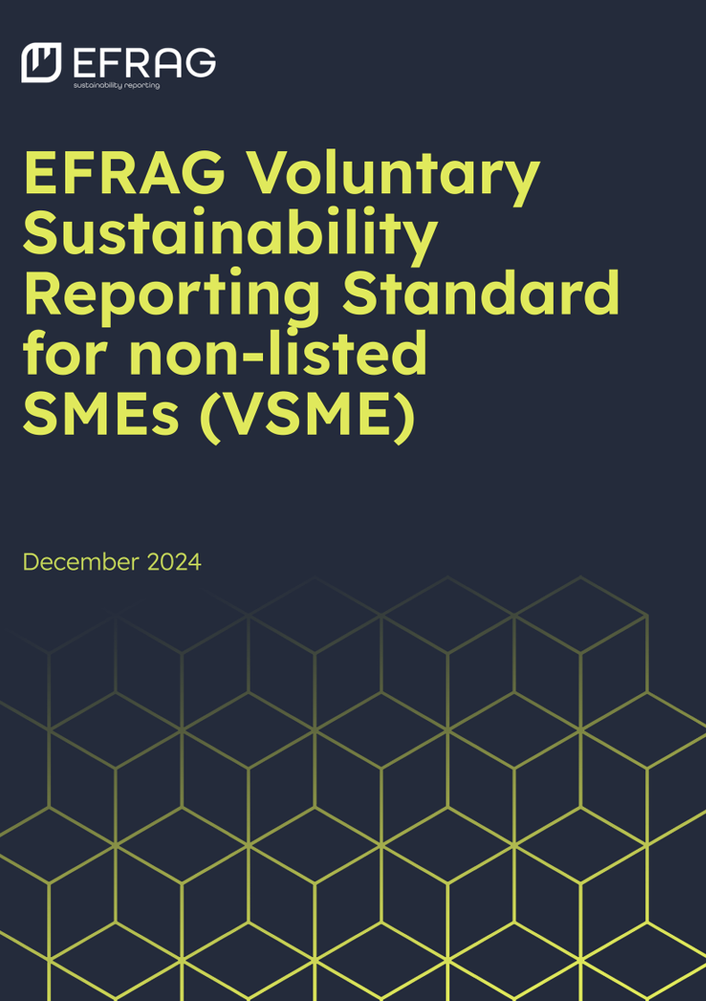
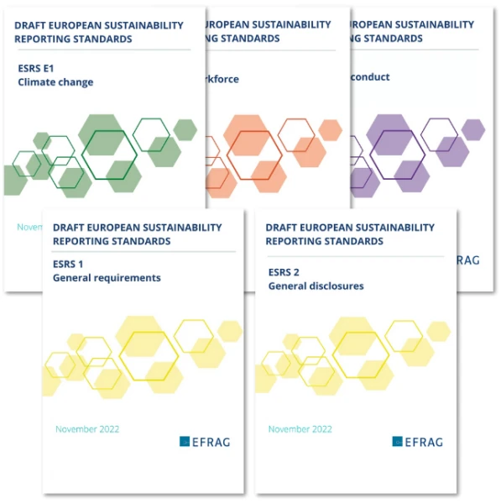
KPI Framework Development Process
SMEs
Large Undertakings
(a) Basic
(b) Comprehensive
(a) Basic
(b) Comprehensive
Context for Redevelopment of the KPI Framework: Relevant EU CSRD Standards
As a first step in aligning the ERA Framework with CSRD, epi first assessed the complete CSRD reporting disclosure requirements for SMEs and Large Undertakings (set out below):
1. SMEs
2. Large Undertakings
Reporting Standard:
EFRAG VSME (Voluntary SME) Standard*
Reporting Standard:
EFRAG ESRS (European Sustainability Reporting Standard)
Basic Module
Comprehensive Module
General Disclosures + 10 Topical Standards
Description:
Disclosures B1 and B2 and Basic Metrics (B3 to B11). This module is the
target approach for micro-undertakings and constitutes a minimum requirement for other undertakings (Small and Medium Enterprise).
Description:
Scope 3 under B3 plus disclosures C1- C9. This module sets datapoints in addition to disclosures B1-B11, which are likely to be requested by banks, investors and corporate clients of the undertaking on top of the Basic Module.
Description:
EFRAG ESRS (European Sustainability Reporting Standard)
Up to 46 disclosures
Basic Module + up to 42 disclosures
Up to 1,144 disclosures
Disclosures selected based on Relevance
Disclosures selected based on Double Materiality Assessment
* Considering the number of companies in scope and the focus of EU Omnibus Proposal on the VSME Standard, we have disregarded the Listed SME (LSME) Standard for the purpose of this project
13
Existing ERA KPI Framework

Slide 14
KPI Framework Development Process
Metrics and Targets were included in the ERA Sustainability KPI Framework 3.0, but Policies and Actions disclosures have been excluded
Metrics form the core KPI framework, and some Targets are also included in order to provide context :
ESRS
General Disclosures
Environmental
Social
Governance
×
Out of scope
ESRS2: General Disclosures
ESRS E1: Climate Change
ESRS S1: Own Workforce
ESRS G1: Business Conduct
Policies
ESRS E2: Pollution
ESRS S2: Workers In The Value Chain
×
Out of scope
Actions
ESRS E3: Water & Marine Resources
ESRS S3: Affected Communities
Metrics
✓
In scope
ESRS E4: Biodiversity & Ecosystems
ESRS S4: Consumers & End Consumers
ESRS E5: Resource Use & Circular Economy
(✓)
In scope
Targets
+ Additional Entity-Specific or Sector-Specific Disclosures
The ESRS Metrics are also supplemented by KPIs from the ERA 2.0 Framework, that are not covered within ESRS.

Slide 15
KPI Framework Development Process
SMEs
Large Undertakings
(a) Basic
(b) Comprehensive
(a) Basic
(b) Comprehensive
ERA KPI Framework 3.0 Structure
The new KPI Framework is split into 4 lists of recommended KPIs, reflecting the company categories delineated by the EFRAG standards:
SME Rental Companies
Large Rental Companies
A shorter selection of KPIs considered suitable for small and medium-sized (SME) rental organisations (2 of 3 criteria: <250 employees; <EUR50m revenue; <25m assets)
A longer selection of KPIs considered suitable for large undertakings (as defined by the EU, (2 of 3 criteria: >250 employees; >EUR50m revenue; >25m assets)) in the Rental sector.
Basic KPIs
Comprehensive KPIs
Basic KPIs
Comprehensive KPIs
Description:
This is the minimum “getting started” KPIs that SME rental companies should consider measuring, tracking and disclosing.
Description:
SME members wishing to enhance their sustainability indicators or cover all those potentially required by stakeholders may also wish to add Comprehensive KPIs.
Description:
A minimum list of KPIs for Large Rental Companies, providing the most meaningful sustainability performance indicators.
Description:
A full list of typically material measures for large rental organisations aiming for a complete, leading practice set of performance indicators.
KPI Selection:
Based on VSME standard, basic disclosures only, material topics only. No voluntary data points.
KPI Selection:
Based on VSME standard, basic + comprehensive disclosures, material topics only
KPI Selection:
Data points from the ESRS, limited to topics deemed clearly material by ERA interviewees. No voluntary disclosures.
KPI Selection:
All topics and sub-topics determined to be likely material by ERA interviewees and epi Consulting. Voluntary disclosures included
Rationale:
SMEs may not be in scope of CSRD for several years and therefore a more refined list of datapoints, based on the basic VSME standard is more manageable. It allows companies to begin to focus on the core datapoints that focus on scope 1 and 2 reporting.
Rationale:
Some SMEs will be looking to go beyond minimum compliance and will be interested in additional disclosures to satisfy stakeholders. Therefore, the comprehensive list of datapoints adds in scope 3 datapoints and further disclosures for organisations looking to get ahead.
Rationale:
Large Undertakings that are looking to begin measuring, tracking and reporting on a set of sustainability datapoints aligned to CSRD may wish to report on KPIs that are typically relevant and material for Large Rental Companies.
Rationale:
Companies looking to measure, track and report a best practice set of KPIs aligned to CSRD can consider an extended set of datapoints in topical areas that have been deemed material by multiple (but not all) companies interviewed.
20 data points*
34 data points*
209 data points*
254 data points*
15
*Note: To comply with CSRD, large undertakings and listed SMEs should still complete a Double Materiality Assessment to determine individual reporting requirements. The ERA 3.0 framework simply provides guidance on commonly material metrics.
Existing ERA KPI Framework

Slide 16
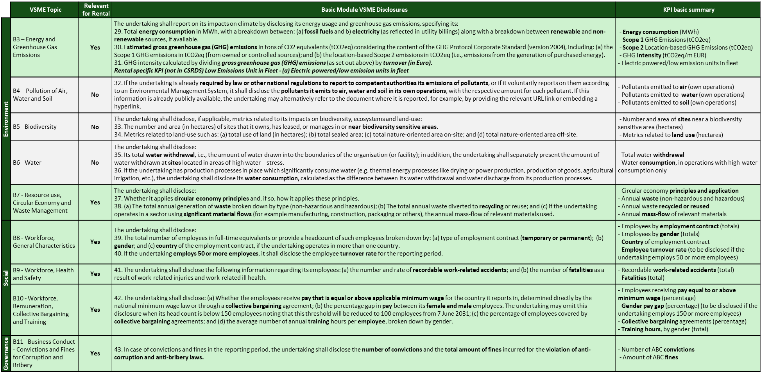
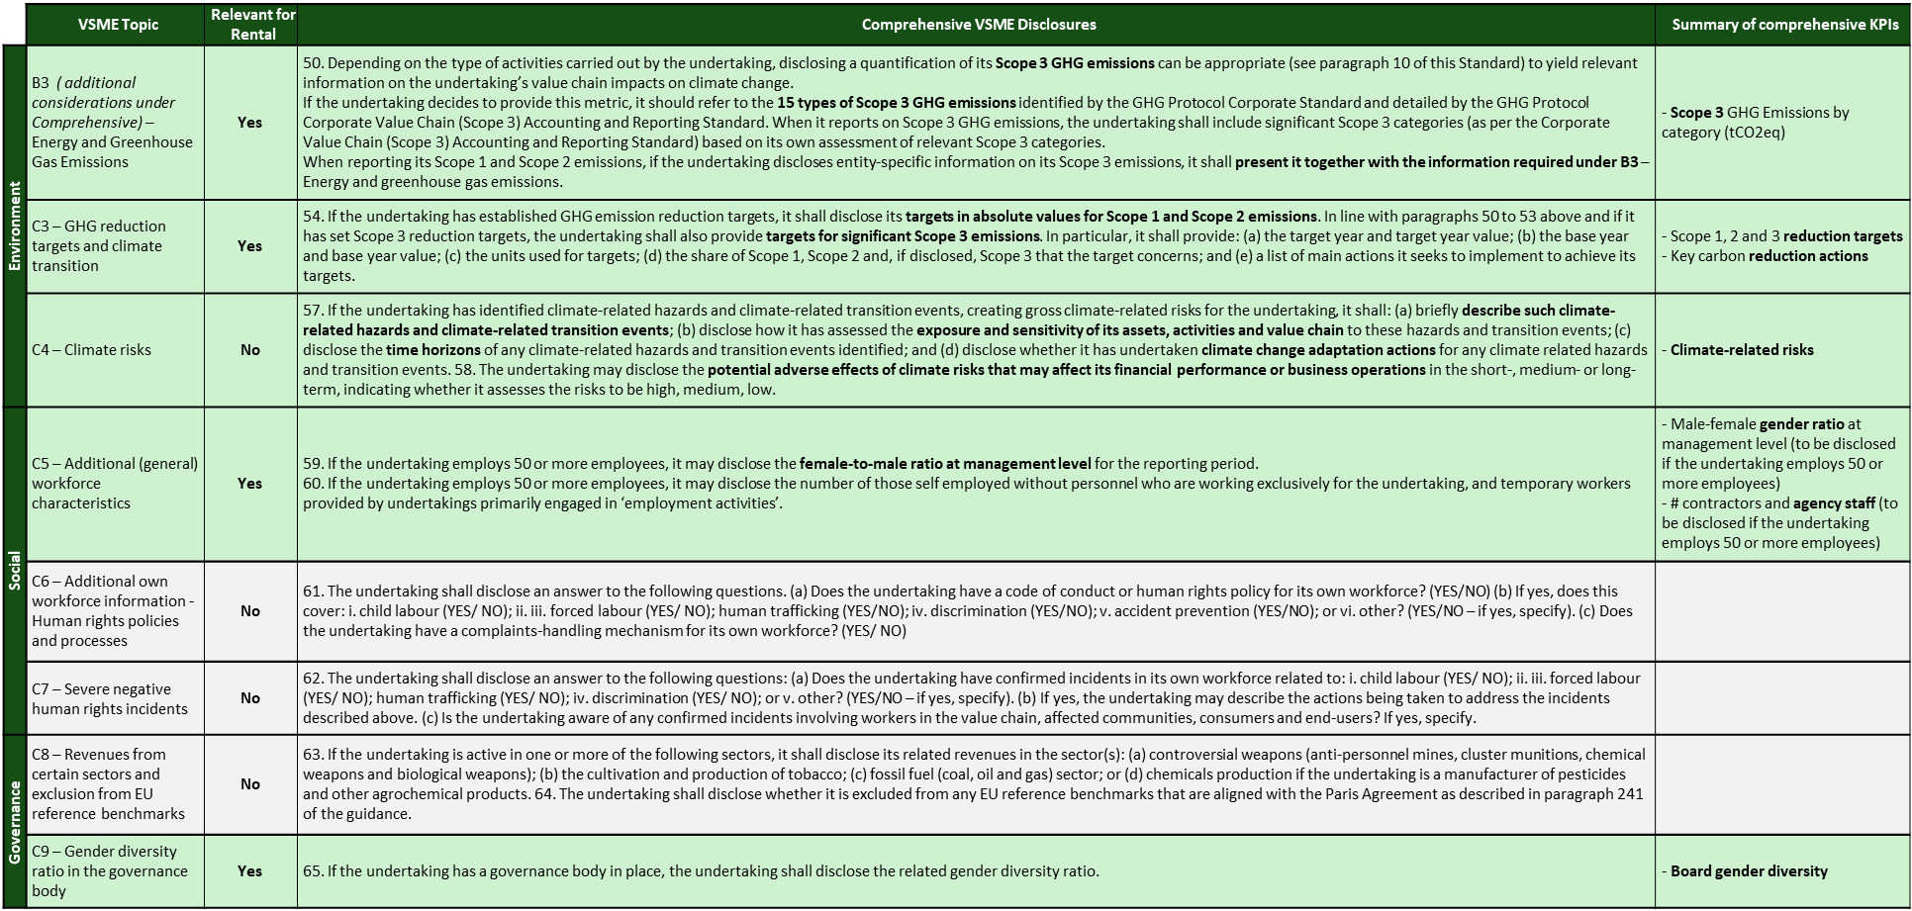
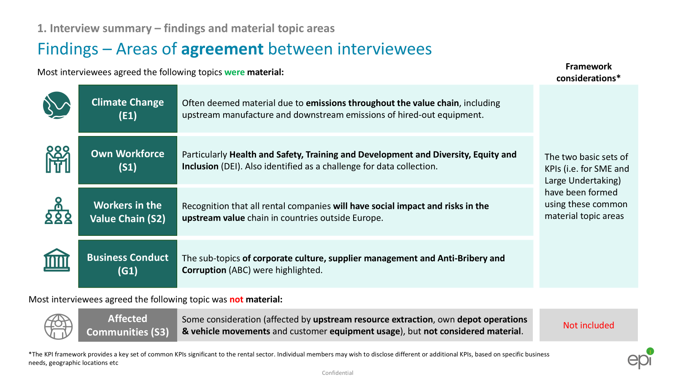
KPI Framework Development Process
SMEs
Large Undertakings
(a) Basic
(b) Comprehensive
(a) Basic
(b) Comprehensive
Selecting Basic and Comprehensive KPIs
Metrics and Targets were selected for inclusion in the 3.0 Framework based on ERA member interview outcomes and the below process. KPIs from the 2.0 framework that have been kept in the 3.0 framework (i.e. sector specific KPIs, not covered in CSRD).
SME KPIs
Large Undertaking KPIs
Basic KPIs
Comprehensive KPIs
Basic KPIs
Comprehensive KPIs
1
Identify clearly relevant VSME KPIs relevant to the Rental Industry
1
Identify clearly material KPIs
1
Identify likely material KPIs*
2
Supplement Comprehensive KPIs with ERA 2.0 “Minimum” KPIs
2
Supplement Basic KPIs with ERA 2.0 “Minimum” KPIs
2
Supplement with ERA 2.0 “Minimum+Good+Best” KPIs
* Voluntary ESRS data points were also added at this stage for all material topics, for the comprehensive KPI list
16
Existing ERA KPI Framework

Slide 17
KPI Framework Development Process
SMEs
Large Undertakings
(a) Basic
(b) Comprehensive
(a) Basic
(b) Comprehensive
Future development of the Framework – potential future CSRD developments
EU Omnibus: The Omnibus Proposal was released in February 2025. If the proposal is adopted, the threshold for companies in scope of CSRD could be amended. It will likely remove around 80% of companies from the scope of the CSRD – so only companies that have more than 1,000 employees and either a turnover above €50 million or a balance sheet total above €25 million will remain subject to the rules.
April 2025: “Stop the clock” approval – potential 2-year delay to CSRD reporting
Omnibus Proposal review period
2029+: Other companies that had been required to comply under CSRD between 2025 and 2029 (depending on location, size, scope of operation) would begin reporting
2025
2028
Possible finalisation of Omnibus and next update to ERA KPI Framework
2028: Companies subject to NFRD and meeting any new in-scope criteria, would report under CSRD in 2028 (2027 fiscal year)
February 2025: Omnibus Proposal – proposed changes to the threshold for reporting under CSRD and potential reduction in datapoints
2026-27
2029+
Anticipated outcomes from the Omnibus Proposal:
Fewer companies in scope of CSRD
Fewer total data points
Existing ERA KPI Framework

Slide 18
To discuss this document further, or to find out more about epi Consulting, please contact:
Ian Corder
icorder@epiconsulting.co.uk
Alan Riley
ariley@epiconsulting.co.uk
www.epiconsulting.co.uk
Disclaimer This report represents data, research and analysis provided by, and opinions interpreted by, epi Consulting (epi) and are therefore indicative in nature and not representations of fact. The information and opinions expressed in this report are subject to change without notice and epi has no ongoing duty or responsibility to update it. While the materials reproduced herein are from sources considered reliable, the accuracy and completeness thereof are not warranted, nor are the opinions and analyses which are based upon it. To the extent permitted by law, epi shall not be liable for any errors or omissions or any loss, damage or expense incurred by reliance on materials or any statement contained in the report, or resulting from any omission. epi accepts no liability for any loss or damage including, without limitation, indirect or consequential loss or damage arising out of, or in connection with. the use of this report. This report does not constitute legal advice. This report does not constitute an assurance opinion.
© Copyright EPINDEX Ltd (epi) 2025. All rights reserved. May not be reproduced or shared without written permission

