Slide 1
ERA KPI Framework Version 3.0
User Guidance
April 2025
Document status: Confidential – Final Draft
© Copyright EPINDEX Ltd (epi) 2025. All rights reserved. May not be reproduced or shared without written permission
Notes:
Backhoe front loader excavator and wind turbines that are generating electricity in the background, the concept of sustainable resources, Beautiful sky with wind generators turbines, Renewable energy.

Slide 2
Introduction to Sustainability KPI Framework Version 3.0
SMEs
Large Undertakings
(a) Basic
(b) Comprehensive
(a) Basic
(b) Comprehensive
Purpose of the ERA KPI Framework in the rental sector
The ERA Sustainability KPI framework provides a practical approach for rental companies implementing a sustainability measurement and reporting framework. Using this objective industry framework, rental companies can adopt or improve Sustainability KPIs, using either a Basic or Comprehensive framework depending on their current size, level of maturity and goals.
Background
Application
Structure
Comprehensive KPIs
Framework Development
The Sustainability KPI Framework was first created in 2021 through a review of over 17 rental companies operating in Europe and the US (Version 1.0). It was then updated in 2023 (Version 2.0) and now again in 2025 (Version 3.0) to account for changes in sustainability reporting requirements in the EU, such as the Corporate Sustainability Reporting Directive (CSRD).
Version 3.0
The newest version of the Framework was created by reviewing relevant topical areas with leading European-based rental organisations. The KPI selection was based on alignment of these topical areas with CSRD reporting standards (ESRS and VSME), plus a selection of supplementary KPIs from the 2.0 ERA framework that are rental sector specific and not covered by CSRD standards.
Stakeholders
Stakeholders (customers, investors, staff, suppliers, regulators, government agencies, NGOs, to name some critical stakeholders) expect, and in some cases increasingly require, rental companies to put in place Key Performance Indicators (KPIs) to measure sustainability performance levels, set targets and report progress against these targets.
EU Sustainability Reporting Objectives
This Version 3.0, prepared for ERA by epi Consulting, provides a sustainability KPI framework that will enable rental companies to implement a flexible solution that considers the size and level of maturity of an organisation, and meet current EU Corporate Sustainability Reporting Directive (CSRD) objectives.
The ERA Sustainability KPI Framework 3.0 is split into 4 lists of recommended KPIs – 2 lists for SMEs and 2 lists for Large Undertakings
For each organisation size, KPIs have been grouped into two categories:
Basic KPIs – KPIs that are most frequently looked at by stakeholders, are most closely aligned with current and future minimum standards for regulatory reporting and are in most common usage.
Comprehensive KPIs – KPIs that can be regarded as good/best practice in sustainability measurement and reporting and would be considered leading practice by stakeholders.

Slide 3
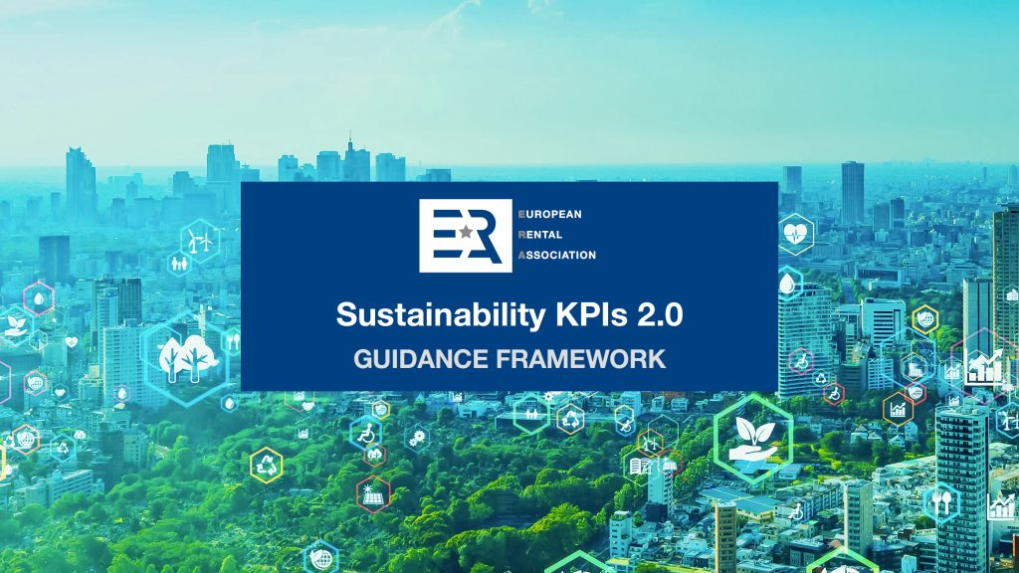
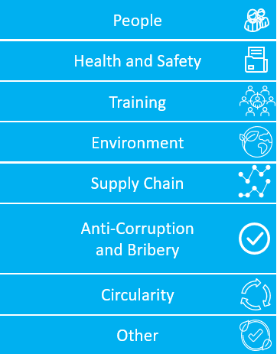
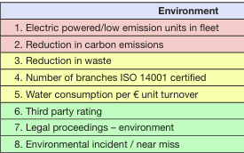
Introduction to Sustainability KPI Framework Version 3.0
SMEs
Large Undertakings
(a) Basic
(b) Comprehensive
(a) Basic
(b) Comprehensive
Development of Sustainability KPI Framework from 2.0 to 3.0
Presented below is the KPI framework 2.0 areas and a summary of updates made to version 3.0:
Framework 2.0
Framework 3.0
epi Consulting were commissioned by the European Rental Association (ERA) to re-develop the KPI framework 2.0 to align it with the requirements and topical areas under the Corporate Sustainability Reporting Requirements (CSRD).
The new Framework 3.0 considers organization size, material sustainability areas in the rental sector and different levels of reporting maturity and ambition. The four disclosure lists are summarized below and explained in more detail later in this report.
Rental companies are recommended to report under one of the four KPI lists only:
Three KPI sets:
KPI category areas:
ESRS KPI category areas:
Four KPI lists:
E1 – Climate Change
SME Rental Companies
(a) Basic KPIs – minimum disclosures (for example, Scope 1 and 2 emissions)
E2 – Pollution
Example:
E3 - Water
(b) Comprehensive KPIs – Basic KPIs above + additional (eg. Scope 3)
E5 - Circularity
S1 – Own Workforce
Large Rental Companies
(a) Basic KPIs – CSRD reporting “getting started”
S2 – Workers in the Value Chain
S4 – Consumers and End Users
(b) Comprehensive KPIs – Aligning with CSRD good and best practice
G1 - Governance

